Slide 1
Information on the OP “Competitiveness and Cohesion“ 2014-2020
Ministry of Economy, Entrepreneurship and Crafts
Croatia
Author: Nataša Kulakowski Kramarić, Assistant Minister
Budapest, May 18, 2017

Slide 2
Main topics
Strategic framework
OP “Competitiveness and Cohesion” 2014-2020 (OPCC)
Overview of the implementation of OPCC 2014-2020 till May 2017
Priority Axis 1 „Strengthening the Economy by Applying Research and Innovation”
Priority Axis 3 „Business Competitiveness”
Financial Instruments
Notes:
Here are the main topics that I would like to present to you today. I will briefly introduce the Strategic framework when it comes to ESI Funds in Croatia for the period 2014-2020..
Then I will talk a bit more about the Operational Program Competitiveness and Cohesion, or OPCC as we call it and I will also provide you with an overview of the implementation of OPCC up to May of 2017. Since I represent the Ministry of Economy I will focus on Priority Axis 1 „Strengthening the Economy by Applying Research and Innovation” and Priority Axis 3 „Business Competitiveness” as well as the use of Financial instruments.

Slide 3
Strategic Framework
Partnership Agreement - adopted in October 2014
Implemented through 4 Operational Programmes:
OP Competitiveness and Cohesion
OP Efficient Human Resources
OP Maritime and Fisheries
Rural Development Programme
Notes:
The Croatian Strategic Framework for ESI Funds for the period 2014-2020 consists of the Partnership Agreement between the European Commission and the Republic of Croatia which was adopted in October of 2014, with 12 strategic priorities (it is actually the first such all-encompassing strategic document in Croatia which serves as a solid base for further planning of investments and programming of operational programs).
There are four OPs which are co-financed by the ESI funds for 2014-2020, OP Competitiveness and Cohesion co-financed by ERDF and CF (with certain ties to the ESF as well); OP Efficient Human Resources is co-financed by the ESF, OP Maritime and Fisheries is co-financed from the EFFA and the Rural Development Programme is co-financed by the EAFRD.
The programming process began in early 2012 and it was completed between the end of 2014 and 2015.
The overall allocation for Croatia from ESI Funds is around 10.6 billion euro and with national cofinancing the total allocation for the implementation of this strategic framework is around 12.5 billion euros for 2014-2020.

Slide 4
ESI FUNDS
European
Social Fund
European Fund for Regional Development
Cohesion Fund
European Fund
for Fisheries and Aquaculture
European Agricultural Fund for Rural Development
Partnership Agreement
Operational Programme Competitiveness and Cohesion 2014-2020
=
6,881 billion EUR
Notes:
Operational Program Competitiveness and Cohesion is mainly co-financed from the ERDF and the amount of the combined allocation from ERDF and CF is 6.881 billion EUR for 2014-2020. With national cofinancing the total allocation for OPCC is around 8 billion euros.
(Croatian administration has never before handled such a big investment program and even programing it was quite a challenge. OPCC is of extreme importance to us since it provides us with significant opportunities to invest into boosting our economy. )

Slide 5
OP Competitiveness and Cohesion
6,881 bn EUR
ERDF
4,321 bn EUR
CF
2,559 bn EUR
10 Priority Axis
24 Investment Priorities
48 Specific Objectives
Notes:
OPCC focuses on 9 thematic objectives (or investment priorities) for ESI funds 2014-2020 and comprises 10 Priority axes which you will see in the next slide, 24 investment priorities and 48 specific objectives.
So OPCC actually encompasses quite a lot of areas, (this is due to the fact that Croatia has really big needs when it comes to investments and development, and during the financing period 2007-2013 for example our possibilitied of investing from EU structural funds and before that IPA were still quite limited since our system was still learning how to handle strategic development and more complex investment schemes and programs.)
In financial terms, again, around 2.7 billion euros is allocated to strengthening the competitiveness of the Croatian economy and investments into innovation, ITC technologies, the development of SMEs and a low carbon economy, with estimated 1.9 billion euro in OPCC specifically dedicated to investments into research and development and innovations for SMEs.

Slide 6
 | OP Competitiveness and Cohesion 2014-2020 Priority Axis | Financial Allocation (EUR)
1. | Strengthening the economy by applying research and innovation | 664.792.165
2. | Use of information and communication technology | 307.952.676
3. | Business competitiveness | 970.000.000
4. | Promoting energy efficiency and renewable energy sources | 531.810.805
5. | Climate change and risk management | 245.396.147
6. | Environmental protection and resource sustainability | 1.987.360.608
7. | Relationship and Mobility | 1.310.205.755
8. | Social Inclusion and Health | 376.500.000
9. | Education, Skills and Lifelong Learning | 259.914.791
10 | Technical assistance | 216.112.612
 | TOTAL | 6.881.045.559
Notes:
Ministry of Economy, Entrepreneurship and Crafts
(MEEC), as the First Level Intermediate Body (IB1), is responsible for implementing measures under:
Priority Axis 1 „Research, Development and Innovation”, measures aimed at supporting R&D&I activities resulting with new products or services
Priority Axis 3 "Business Competitiveness„, measures aimed at encouraging small and medium-sized enterprises (SMEs).

Slide 7
Priority Axis 1 – Strengthening the Economy by applying Research and Innovation
INVESTIMENT PRIORITY (IP) | SPECIFIC OBJECTIVE (SC) | INDICATIVE ALOCATION | IB 1
1a Improving infrastructure and capacity for research and innovation (R & I) in order to develop the success R & I and promoting centers of competence, in particular those of EU interest | SC 1a1 Increased capacity of sector research and development (R & D) for carrying out research of high quality and meeting the needs of economy | 334.321.739 € | Ministry of Science and Education
1b Promoting business investment in R&I, developing links and synergies between enterprises, research and development centres and the higher education sector, in particular promoting investment in product and service development, technology transfer, social innovation, eco-innovation, public service applications, demand stimulation, networking, clusters and open innovation through smart specialisation, and supporting technological and applied research, pilot lines, early product validation actions, advanced manufacturing capabilities and first production, in particular in key enabling technologies and diffusion of general purpose technologies | SC 1b1 New products and services as a result of activities of research, development and innovation (R & D &I) | 205.000.000 € | Ministry of Economy, Entrepreneurship and Crafts
 | SC 1b2 Strengthening the activities of research, development and innovation (R & D & I) of business sector through the creation of a favorable innovation environment | 125.470.426 €
TOTAL |  | 664.792.165 €

Slide 8
Priority Axis 1 – Strengthening the economy by applying research and innovation
Research, Development and Innovation
Increasing the development of new products and services arising from R & D activities (IRI public call)
100.000.000,00 eur (phase I)
105.000.000,00 eur (phase II)
Phase I : from April 2016 until the 31.12.2019
Phase II: I. quarter 2018 - the utilization of resources/ 31.12.2020
Support for the development of Centers of Competence
105.000.000,00 eur
Phase I: from August until November 2016
Phase II: from March 2017 until the 31.12.2017
Source of financing: European Fund for Regional development (EFRD)
.

Slide 9
Priority Axis 1 – Strengthening of Economy by applying Research and Innovation
2 calls for proposals published worth 205 mil €
4 grants awarded worth 7,5 mil € (by May 5, 2017)

Slide 10
EU funds:
Competitive Entrepreneurship for new jobs
Europe 2020
Smart, sustainable & inclusive growth of economy & society
SME Development Strategy 2013-2020
Increasing the number of SMEs and share in GDP
EU funds for entrepreneurs
Supporting competitiveness
Increasing competitiveness
Increasing productivity
Reducing the cost per employee
Increasing employment

Slide 11
Priority Axis 3 – Business Competitiveness
EFRD: 970 mil €
National co-financing: 171 mil €
Total Investments: 1,141 bn €
Divided into 4 specific objectives:
Better access to finance for SMEs
Enabling favorable environment for business creation and development
SMEs innovativeness enhanced
SMEs' development and growth in domestic and foreign markets improved
250.000.000 €
233.000.000 €
180.000.000 €
307.000.000 €

Slide 12
Priority Axis 3 – Business Competitiveness
INVESTIMENT PRIORITY (IP) | SPECIFIC OBJECTIVE (SC) | INDICATIVE ALOCATION | IB 1
3a Promoting entrepreneurship, in particular by facilitating the economic exploitation of new ideas and fostering the creation of new firms, including through business incubators | SC 3a1 Better access to finance for SMEs | 250.000.000 € | Ministry of Economy, Entrepreneurship and Crafts
 | SC 3a2 Enabling favorable environment for business creation and development | 233.000.000 €
3d Supporting the capacity of SMEs to grow in regional, national and international markets, and to engage in innovation processes | SC 3d1 SMEs' development and growth improved in domestic and foreign markets | 307.000.000 €
 | SC 3d2 SMEs innovativeness enhanced | 180.000.000 €
TOTAL |  | 970.000.000 €

Slide 13
Priority Axis 3 – Business Competitiveness
14 calls for proposals published with a total value of grants 447,8 mil €.
324 grants awarded worth 81 million € with a total investment value of 241 mil €. (by May 5, 2017 )
7 new calls planned to be launched by the end of 2017 with total value of 52,5 mil €

Slide 14
Statistics on May 5, 2017, for the 14 Published Calls
No of applications received | No of applications processed | No of applications in process | No of Financing decisions | Value of Financing decisions/ grants awarded (kn) | No of Contracts signed | Total value of contracted projects (kn) | Total Value of awarded aid for contracted projects (kn) | Amount paid (kn) | Total amount of approved eligible expenditure (kn)
3.364 | 2.906 | 460 | 368 | 741.599.952 | 324 | 1.831.927.569 | 614.980.937 | 190.453.227 | 480.171.760
Notes:
na Poziv E-impuls pristiglo je 2099 projektnih prijedloga koji su na obradi u HAMAG-BICRO-u

Slide 15
Planed calls until the end of 2017
(total value 52,5 mil €)
INDICATIVE ALOCATION (€) | TITLE OF THE CALL | PLANNED DATE OF PUBLICATION
3 mil | Providing high-quality services to SMEs through Business Support Institutions (BSOs) | May
5 mil | Internationalisation of growing and innovative SMEs through BSOs | June
3 mil | Supporting companies in meeting standards, with the aim of improving market access and increasing competitiveness | September
1 mil | Supporting enterprises in acquiring quality signs to improve access to markets and increase competitiveness. | September
10 mil | Innovations of newly established SMEs | September
28,5 mil | Competitiveness and Development of SMEs | September
2 mil | Increasing the competitiveness and efficiency of SMEs through ICT | November

Slide 16
Financial instruments - actors
Managing Authority
„OPCC 2014 - 2020”
MRDFEU
Fund Manager(s)
HAMAG BICRO
&
HBOR
Financial Intermediaries
COMMERCIAL BANKS
Notes:
The Managing Authority : Signs a Contract with Fund Managers Governes and is responsible for the overall implementation of the OPCC
Fond Manager(s) : Selects commercial banks for cooperation, defines the criteria to be achieved and monitors their implementation by carrying out control over the execution of contracted activities, reporting to MRRFEU)
HAMAG-BICRO= Croatian Agency for SMEs, Innovations and Investments
HBOR=Croatian Bank for Reconstruction and Development
Financial intermediaries: (Administrative agents, payment agents and insurance agents)

Slide 17
Financial Instruments
Product | ESIF Contribution (EUR)
Developmental Micro&Small Loans | 45.000.000
Guarantees | 70.000.000
Subsidies (towards guaranteed loans) | 10.000.000
Growth and Expansion Loans | 110.000.000
Venture loans | 15.000.000
Venture capital | 20.000.000
TOTAL | 270.000.000

Slide 18
HAMAG-BICRO –
ESIF Financial Instruments Allocation
Instrument / Product | ESIF (EUR)
Micro & small development loans | 45.000.000
Guarantees (Individual&Portfolio) | 70.000.000
Interest subsidies | 10.000.000
TOTAL | 125.000.000

Slide 19
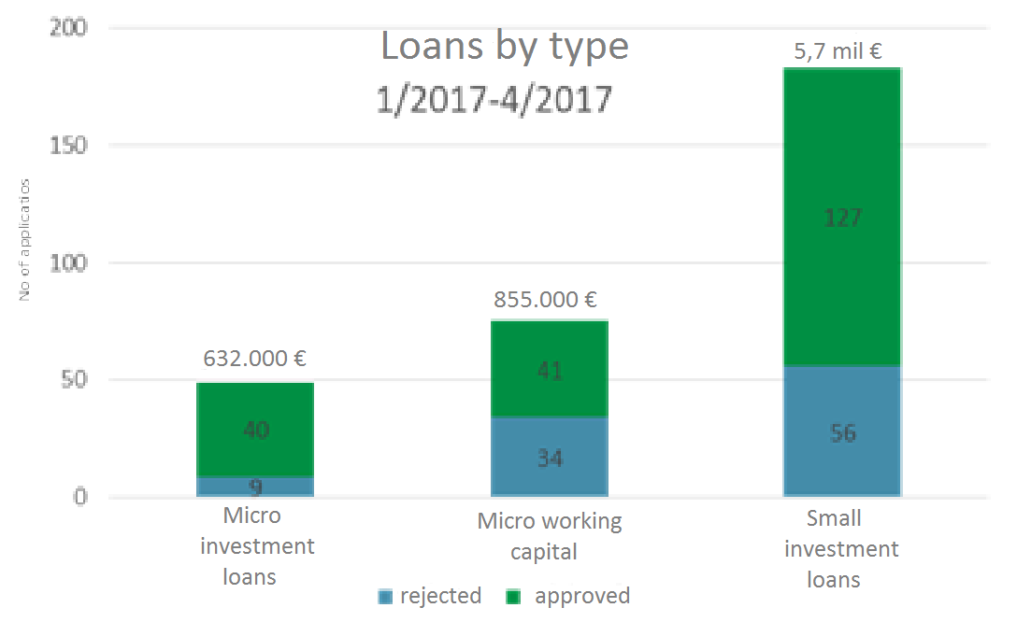
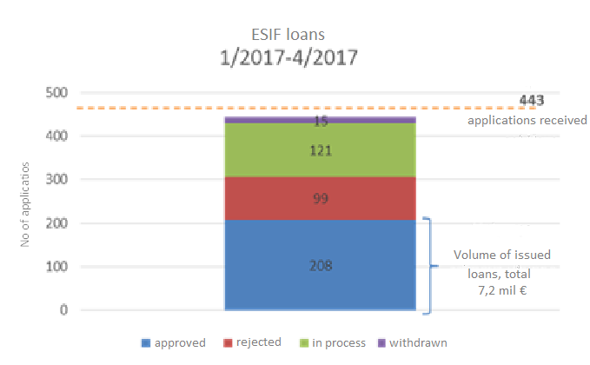
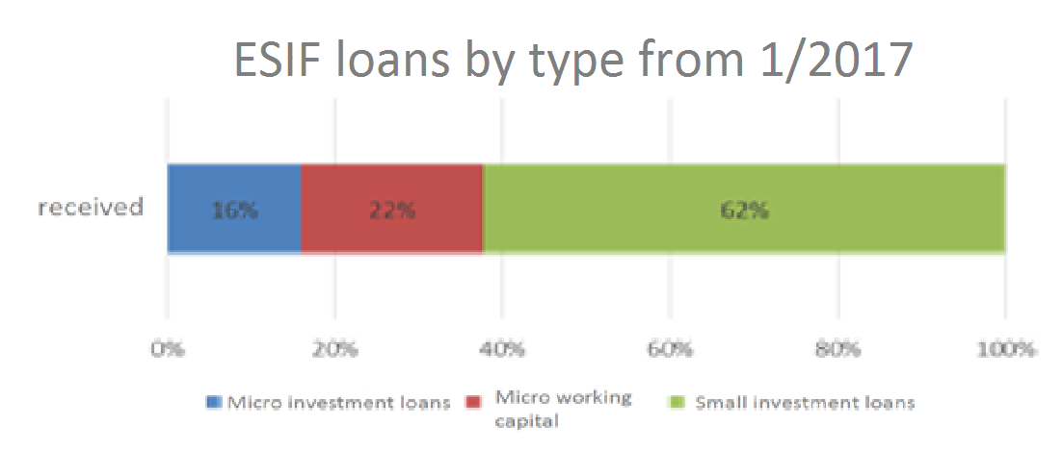
ESIF Loans

Slide 20
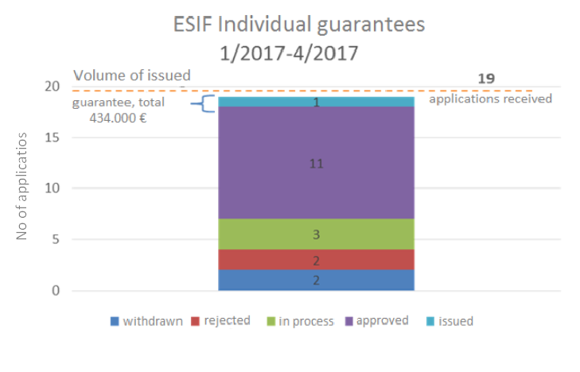
ESIF guarantees

Slide 21
HBOR
ESIF „Growth and Development Loans’’
Expected start – June 2017
Investments loans for growing SMEs
0% Interest rate on ESIF share of financing
Repayment periods up to 12 years
(17 years in tourism sector)
Loan amount from 100.000 EUR to 3mil EUR (10 mil EUR in tourism sector)
Risk Division Model with Selected Banks (50%:50%)
11
Notes:
Expected start – June 2017
21

Slide 22
Thank you for your Attention
More information regarding published and future calls on:
www.strukturnifondovi.hr
www.mingo.hr

