Slide 1
Economic Development and Innovation Operational Programme
(2014-20)
Tamás Karsai
Head of Managing Authority
Budapest, 18 May 2017

Slide 2
Content of the presentation
General overview about the Operational Programme
Evaluation of the institutional background - organisation of MA;
State of play;
Introduction of priorities - measures
Financial instruments;
Major Project – ELI ALPS
Lessons learned – Challenges, benefits, success stories

Slide 3
Launching of the New Programme – Hungarian OPs 2014-2020
Name of the Operational Programme | million EUR
Economic Development and Innovation Operational Programme (EDIOP) | 8 813
Competitive Central-Hungary Operational Programme | 927
Territorial Operational Programme (TOP) | 3 971
Integrated Transport Development Operational Programme | 3 920
Environment and Energy Efficiency Operational Programme | 3 785
Human Resources Development Operational Programme | 3 070
Public Administration and Services Operational Programme | 935
Rural Development Programme | 4 174
Hungarian Fisheries Operational Programme | 51
OP for Supporting Socially Disadvantaged Persons | 111
+ direct Single Area Payment Scheme | 7 643
Total | 37 400

Slide 4
Economic Development and Innovation OP – Priorities
Capacity building
Modern business infrastructure
Entrepreneurship
Clustering, access to foreign market
R&I infrastructure and capacity
Business R&I
Strategic R&I cooperation
Preservation of natural and cultural heritage
Competitive ICT sector
Digital economy
Digital catching-up
Broadband
Energy efficiency and renewable energy
Employment programmes
Trainee programmes
Flexibility at work
Training
1. SME
≈ 1582
M EUR
2. R&I
≈ 1688
M EUR
3. ICT
≈ 455
M EUR
4. Energy
≈ 226
M EUR
5. and 6. Employment and training
≈ 2150
M EUR
7.Tourism
≈ 361
M EUR
8. Financial Instruments ≈ 2352 M EUR

Slide 5
„Evolution” of the institutional background managing EU Funds in Hungary
Institutional Structure

Slide 6
2004-2006
2007-2013
2014-2020
National Development Agency
Ministry
Ministry
Ministry
Prime Minister’s Office
(Central coordinating body)
OP 1. Managing Authority
OP 2. Managing Authority
OP 3. Managing Authority
Ministry
Ministry
Ministry
Intermediary Body
Intermediary Body
Intermediary Body
OP 1. Managing Authority
Intermediary Body
OP 2. Managing Authority
Intermediary Body
OP 3. Managing Authority
Intermediary Body
Intermediary Body
Intermediary Body
Intermediary Body
Intermediary Body
Intermediary Body
Intermediary Body
Intermediary Body
Intermediary Body
Intermediary Body
Intermediary Body
Intermediary Body
Intermediary Body

Slide 7
Role of Ministry for National Economy
Prime Minister’s Office
Central coordinating body between MAs
Providing common IT system for all calls for proposals
Ministry for National Economy
Territorial
OP
EUR 3 971 million
Counties, capital of counties
Competitive Central-Hungary OP
EUR 927 million
Budapest, Pest county
Economic Development and Innovation OP
EUR 8 813 million
Convergence regions
MA ( incl. IB)
MA (incl. IB)

Slide 8
Organizational structure of the EDIOP Managing Authority
Deputy State Secretary for Economic Development Programmes –Managing Authority
Department of Operational Management
Financial and Monitoring Dep. of Priority Projects
Department of Program Coordination
Department of Finance and Monitoring
Project Management (I) – decision making, contracting
Project Management (II) – Reimbursement
Department of Strategy
Regulatory and Audit Dep
Department of Financial Instruments
Project Management (III) – On the spot controls
Project Management (IV) – Complaint management, irregularities
IT and Support Department
Department of Information Service and Public Relations
Programme management
Project management – Ex IB

Slide 9
State of Play Committed and disbursed funds

Slide 10
State of Play Committed and disbursed funds
Priorities | Total budget | Submission |  | Commitment |  | Disbursement
 | M EUR | number | M EUR | number | M EUR | M EUR
EDIOP-1: SME | 1 582 | 9 310 | 1 721 | 3 037 | 526 | 306
EDIOP-2: R&I | 1 688 | 4 125 | 2 643 | 460 | 860 | 659
EDIOP-3: ICT | 455 | 628 | 362 | 146 | 204 | 100
EDIOP-4: Energy | 225 | 126 | 8 | - | - | -
EDIOP-5: Employment | 1 713 | 2 747 | 1 396 | 923 | 1 255 | 203
EDIOP-6: Training | 437 | 5 | 188 | 5 | 188 | 169
EDIOP-7: Tourism | 360 | 97 | 358 | 29 | 118 | 70
EDIOP-8: Financial Instruments | 2 353 | 3 | 2 033 | 3 | 2 033 | 475
Total | 8 813 | 17 041 | 8 709 | 4 603 | 5 184 | 1 982
Aim: announce calls covering the total budget
until 31.03. 2017 - SUCCEEDED

Slide 11
Introduction of the priorities 1-7. (non-refundable grants)

Slide 12
Introduction of priorities – 1.
Priority 1. SME development
Capacity building with the special focus on:
manufacturing industry and
less developed micro regions;
Modern business infrastructure (logistic centres, industry parks, incubators)
Entrepreneurship (mentoring)
Supporting networks: Cluster development, supplier programme;
Access to foreign market
Measures
Priority 2. Research, technology development and innovation
Business R&I - Supporting R&I activities at enterprises
Strategic R&I cooperation
R&I infrastructure and capacity (Universities, Research centres, Public institutes with R&D activities…)
Measures

Slide 13
Introduction of priorities – 2.
Priority 3. ICT development
Competitive ICT sector – assisting ICT companies to access foreign market;
Digital economy;
Digital catching-up;
Broadband development;
Measures
Priority 4. Energy
Measures
Improving energy efficiency of buildings by using renewable energy

Slide 14
Introduction of priorities – 3.
Priority 5. Employment
Access to employment for job seekers and inactives
Sustainable labour market integration of youth - Youth Guarantee
Adaptability of workers and companies
Measures
Priority 6. Competitive workforce
Measures
Life long learning
Adapting vocational and adult training systems to labour market needs
Priority 7. Tourism
National Castle and Fortress Programme;
Infrastructural development of active touristic networks;
Complex tourism development of health resort;
Development of religious cultural heritages, National Parks and world heritages sites;
Measures

Slide 15
Financial Instruments

Slide 16
Indicative proportion of financial instruments (Larger budget compared to 2007-13)
TO 3
SME – access to finance ≈726 m EUR
2014-20
2 352 m EUR
TO 1
R&I financial programmes for enterprises ≈ 652 m EUR
ICT services, Broadband development ≈ 306 m EUR
TO 2
Energy efficiency for enterprises and for households
≈ 568 m EUR
TO 4
2007-13
727 m EUR
TO 8
Employment programmes, social enterprises ≈100 m EUR

Slide 17
Institutional background for the management of financial instruments 2/1
Managing Authority at MNE*
Prime Minister’s office
Thematic policy responsibles
Appointment of MFB by law
Hungarian Development Bank
Financial instruments:
Loan, combined products (grant+non refundable), VC
Sales network: Info Points
Final beneficiaries
* Ministry for National Economy

Slide 18
Financial Instruments
Loan Instruments
Combined Instruments
Venture Capital
Supporting R&D&I activity at enterprises
Supporting R&D&I activity at enterprises
National Technology and IP VC Programme
TO 1 (R&D)
S3 VC Programme
National Equity Fund
TO 2 (ICT)
Broadband development
ICT development at enterprises
Specialized seed and pre-seed VC for new ICT SMEs
Capacity building at SMEs
TO 3 (SMEs)
SMEs' competitiveness (launched in May 2016)
Irinyi VC programme (industry focus)
Medium sized enterprises in food processing industry
TO 4 (Energy)
Energy efficiency of buildings
Energy efficiency developments with renewable energy sources
Energy efficiency of SMEs
TO 8 (Employment))
Employment growth

Slide 19
Major project – ELI ALPS

Slide 20
ELI-ALPS phased major project in Szeged -2/1
Basic information
Intensity rate:100%
Beneficiary: ELI-HU Research and Development Non-profit Ltd.
Preparation phase: 2011-2013
Implementation: 01.01.2013 – 30.06.2019
Total budget: 231.4 mEUR
Phase | Approved budget (mEUR) | Status
Phase 1. 2007-13 (EDOP) | 97.9 | Finished
Phase 2. 2014-20 (EDIOP) | 133.5 | In progress
Current status
Building and infrastructure works completed:
5 buildings (total 24 462 m²⁾ in 10 hectares are ready
Roads, public utilities and a rainwater pond in 6.6 hectares,
3.5 km long water channel and sewage pipes
Research technology:
Procurement and manufacturing of the laser systems progress at good pace. Instalment of laser systems is scheduled to start in Q2 2017 and finish in Q4 2018.
ELI ERIC: Setting up the responsible organization for joint operation of 3 ELI projects (CZ, RO, HU) is in progress at expert level

Slide 21
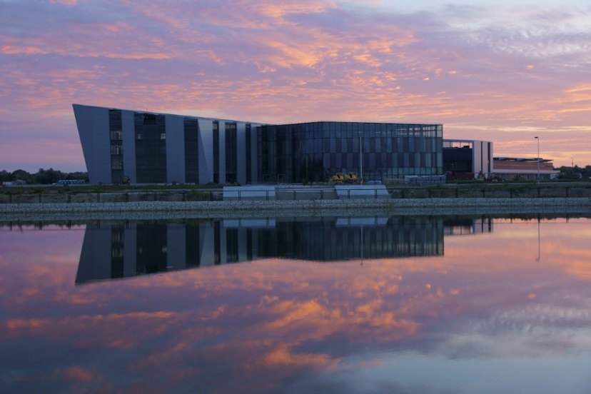
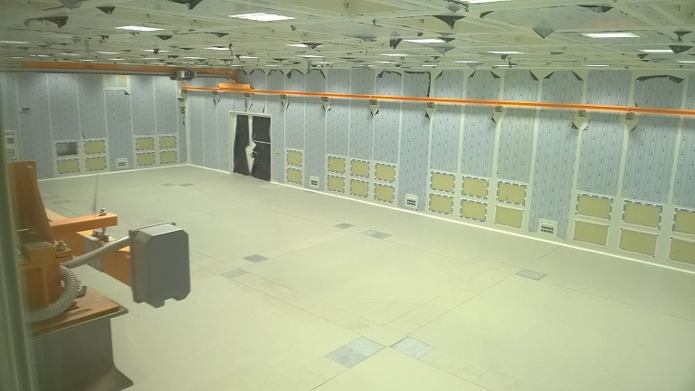
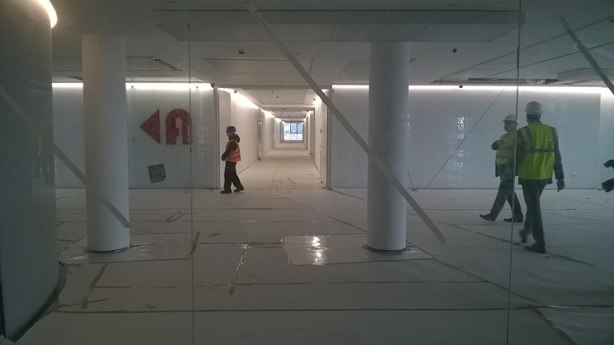
ELI-ALPS phased major project in Szeged -2/2 http://www.eli-alps.hu/?q=en

Slide 22
Lessons learned – Challenges, benefits, success stories from the past 10 years

Slide 23
Lessons learned – challenges, benefits from the past 10 years -1.
R&D&I
Moving toward market close innovation;
Supporting small scale innovation - Increased the willingness for innovation - SMEs realized that they have innovative activities;
Low level at willingness of cooperation among business actors - Initiating joint R&I projects – cooperation between research and business sector;
Enterprise
development
Issue of large enterprises:
2007-13: Last period for supporting large enterprises at general level;
2014-20: Large enterprises are eligible at specific topics;
Complex development of projects: infrastructure, building, technology modernisation, training, access to foreign market…;
Instead of general SME development programmes focusing on specific sectors, topics:
Manufacturing industry;
Job creation at less developed areas;
Initiating SMEs to implement Industry 4.0 solutions;
SME internationalisation – access to market;

Slide 24
Lessons learned – challenges, benefits from the past 10 years -2.
Modern business
infrastructure
Logistic infrastructure, industry parks, incubators: no need for new infrastructure but upgrading and widening their service level;
Financial instruments
Change of attitude: moving from non-refundable grants toward refundable instruments;
Start using combined instruments;
IT background
E-administration, On-line communication;
Less paper, decreasing the rejection rate;
Integration of ESF
Joint management of ERDF and ESF financed programmes is a challenge;
Project selection
Introducing simplified procedure: well defined call for proposals;
Audit
Innovation content of the project (NRDIO, National IPR Office );
Market price assessment – 3 bids, documentation of price assessment;
Suitability of project implementation location;
Verification of SME status;

Slide 25
Thank you for your kind attention! Ministry for National Economy Managing Authority for Economic Development Programmes

