Slide 1
Progress in the implementation of OP Innovation and Competitiveness 2014-2020
European Union
European Fund for Regional Development
Budapest, 18.05.2016
GD European funds for Competitiveness
Ministry of Economy
Bulgaria

Slide 2
UNION SUPPORT 2014 – 2020 /1
PARTNERSHIP AGREEMENT 2014-2020 | 9,878
OP Innovation and Competitiveness | 1,080
OP SME Initiative | 102
OP Regions in Growth | 1,312
OP Transport and Transport Infrastructure | 1,604
OP Environment | 1,505
OP Science and Education for Smart Growth | 596
OP Development of Human Resources | 939
Good Governance | 286
Rural Development Programme | 2,367
Maritime and Fisheries Programme | 88

Slide 3
UNION SUPPORT 2014 – 2020 /2

Slide 4
OP Innovation and Competitiveness
R&D and innovation in enterprises
Innovation infrastructure
Science and technology parks
EUR 259 million
Entrepreneurship
Production capacity
ICT, standards and management systems
EUR 577 million
PA 1 Technological Development and Innovation
PA 2 Entrepreneurship and
Capacity for Growth of SMEs
OP INNOVATION AND COMPETITIVENESS
1,270 MEUR
Management and control of OP
EUR 41 million
PA 5 Technical Assistance
Energy efficiency in enterprises
Institutional support
Resource efficiency
EUR 311 million
PA 3 Energy and Resource Efficiency
PA 4 Removing
bottlenecks in
security of gas supplies
Construction of gas interconnector Bulgaria - Serbia
EUR 45 million

Slide 5
OPIC Implementation Update
EUR 516.4 million, i.e. 41% of OPIC budget, launched in 7 calls for proposals, 7 direct award procedures and 4 budget lines
Funding Agreement for EUR 235 million for implementation of financial instruments signed
1 155 grant contracts signed with a total grant amount of EUR 586 million (45% of the total OP budget)
801 projects in implementation, 286 projects completed
EUR 184.7 million grant paid, incl. EUR 58.75 million in FI (15% of the total OP budget)

Slide 6
PA 1 Technological Development and Innovation
2 calls for proposals and 2 direct award procedures launched
Support for introducing and development of innovation in enterprises
Support to Sofia Tech Park and Patent Office
Total budget (grants) – 66.4 MEUR
Total budget (FI) - 60 MEUR
Eligible applicants - micro, small, medium and large enterprises; institutions
Competitive procedures distribution per category of enterprise

Slide 7
PA 1 Sofia Tech Park Project
BASIC INFO
Government-driven project, designed to advance research, innovation and technology growth in Bulgaria
40 MEUR support for Phase I from OP “Competitiveness” 2007-2013 and 6.4 MEUR for Phase II from OPIC 2014-2020
Platform where members of the innovation ecosystem in Bulgaria can meet, share ideas and collaborate
FOCAL AREAS
COMPONENTS
Laboratory complex
Managed by R&D&I Consortium
Information and communications technology
Incubator
Managed by “Operator”
Innovation forum
Managed by R&D&I Consortium
Life Sciences & Biotechnology
Green Energy
& Cleantech
Museum / Experimentarium
Public-private partnership
Sport complex
Managed by “Operator”

Slide 8
PA 2 Entrepreneurship and capacity for growth of SMEs
3 calls for proposals and 5 direct award procedures launched
Support for improvement of production capacity of SMEs - 205 MEUR
Support for management capacity development, introduction and certification of international standards of SMEs – 30 MEUR
Support for cluster development – 20 MEUR
Support to SME Promotion, InvestBulgaria, Metrological and Technical Surveillance and Bulgarian Accreditation Service Agencies; Consumer Protection Commission– 16 MEUR
Total budget (grants) – 270.4 MEUR
Total budget (FI) – 135 MEUR
Eligible applicants - micro, small, medium and enterprises; institutions
Competitive procedures distribution
per category of enterprise
400.9 MEUR grant requested
232.8 MEUR grant committed

Slide 9
PA 2 SMEs PROMOTION AGENCY PROJECTS
Government institution established in 2004 to implement the Bulgarian Government’s policy for SMEs
Government support of 11.8 MEUR in 2007-2013
5 MEUR of support approved under OPIC 2014-2020
3 projects in implementation and 1 completed
Focus of the support
2007-2013 Results
Internationalization of SMEs
Participation of SMEs in trade missions and business forums
Participation of SMEs in trade fairs and conferences
New technologies
for
better e-services
946 SMEs trained in skills for successful development on international markets
1750 SMEs supported to participate in trade missions, business delegations and B2B meetings
1312 SMEs supported to participate in international fairs
121 market analyses of industrial sectors in different countries developed

Slide 10
PA 3 Energy and Resource Efficiency
2 calls for proposals launched
Support for energy efficiency in SMEs
Support for energy efficiency in large enterprises
Total budget (grants) – 140 MEUR
Total budget (FI) - 40 MEUR
Eligible applicants - micro, small, medium and large enterprises

Slide 11
FINANCIAL INSTRUMENTS OP Innovation and Competitiveness

Slide 12
General Overview of the Financial Instruments
Common Framework
Contribution in MEUR and OPIC share
FI
Final Recipients
Technology Transfer Fund
SME& Large Enterprises
30 М
90%
Acceleration & Seed Fund
SMEs
Total contribution of OPIC ‒ 235 MEUR, distributed in 7 financial instruments
A minimum amount of private co-financing of 340 MEUR or a total amount of support for final recipients up to 575 MEUR
Expected leverage ‒ 2,45%
A minimum co-financing by the Financial Intermediaries
55 М
90%
Venture capital Fund
SMEs
25 М
60%
OPIC Contribution (235 MEUR)
Growth Fund
(Mezzanine)
SMEs
40 М
60%
First Loss Portfolio Guarantee*
SME& Large Enterprises
70 М
80%
Risk Sharing of Micro Financing Instrument
SME/ Micro Enterprises
15 М
70%
Private co-financing (approximately 340 MEUR)
*FLPG includes 2 instruments ‒ for innovation and energy efficiency

Slide 13
Financial Instruments Progress
Technology Transfer Fund
30 MEUR
R&D&I projects in an early stage deriving from Universities, Tech Parks and Science Labs
Projects in thematic Areas of RIS3
Market tests completed
FI selection start in 3rd Qr. ‘17
Acceleration and Seed Fund
55 MEUR
Integrated approach to supporting start-ups
Investment focus on pre-seed and seed companies
Market tests completed
FI selection start in 3rd Qr. ‘17
Venture Capital Fund
25 MEUR
SMEs in their early-stage of development to achieve commercialisation, strengthen high-growth prospects, innovate, and expand
Market tests preparation
FI selection start in 4th Qr. ‘17
Growth Fund (Mezzanine)
25 MEUR
Alternative forms of finance to high-growth SMEs with expansion plans
Particular emphasis on strengthening the managerial capacity, corporate governance, and reporting systems
Market tests completed
FI selection start in 3rd Qr. ‘17
FLPG
30+30 MEUR
High-risk innovative projects and energy efficiency projects
Reducing interest rate and collateral level
FI structuring and selection
in 2018
Microfinancing
15 MEUR
Risk-shared micro loans
Micro and small companies in regions with high disparity which have never received a loan
FI structuring and selection
in 2018

Slide 14
OP SME INITIATIVE

Slide 15
Implementation update /1
Mandate statistics as of 31st December, 2016
Highlights
Portfolio by SME type
Medium
Portfolio by Industry, NACE1
6.9m
Originated as of 31 Dec, 2016
Admin & Support
Services
Small
Trade &
Vehicle Repair
86
SMEs supported
Micro
25%
Collateralization level¹
Construction
Portfolio by loan purpose
3.4%
Interest rate²
Tangible
Investments
Transportation &
Storage
Other
Working
capital
Manufacturing
5.3%
Market rate for loans in BGN up to EUR 1m with maturity >1y and <5y³
Accommodation
& Food
Scientific & Tech
Activities
Progress
Note: Based on principle amounts
2016
31st Dec
30th April
2017
2018
2019
31st Dec
1.1%
9.61%
Feb, 2017: All 10 banks started originating
Target vol: EUR 608m
2nd March, 2016:
Financial Agreement signature
Dec, 2016: 4 banks started originating, SMEI political commitment fulfilled
Nov, 2016: 5 transaction signatures
¹Not all banks report collateralization rates as of Q1 2017
²The principle amount is used to calculate a weighted average interest rate
³BNB Statistics, February 2017, Interest Rates and Volumes of New Business on Loans to Non-financial Corporations

Slide 16
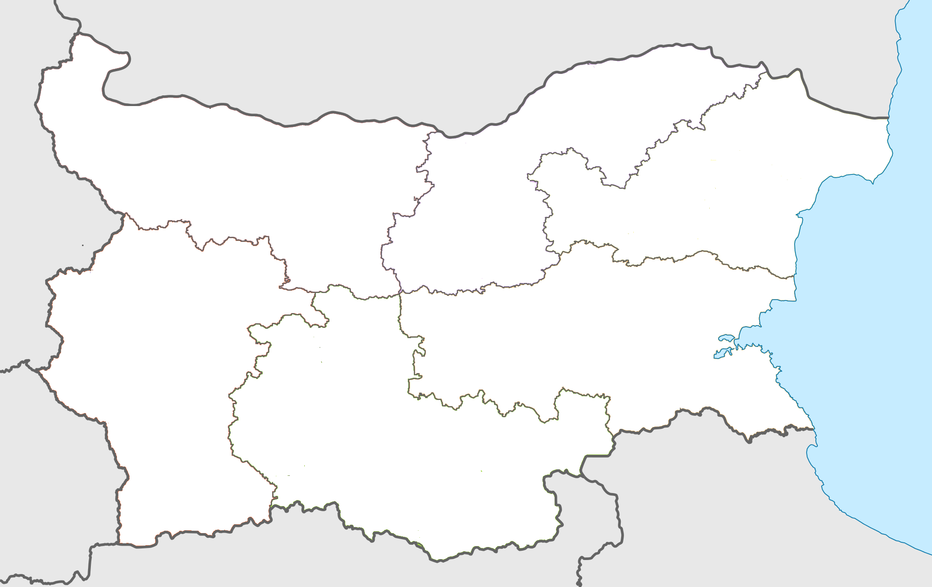
Implementation update /2
Regional statistics – NUTS 2 as of 31st December, 2016
North-Western
North-Central
North-Eastern
Trade &
Vehicle Repair
Construction
Construction
Trade &
Vehicle Repair
Trade &
Vehicle Repair
Manufacturing
Transportation &
Storage
Transportation &
Storage
Accommodation
& Food
Transportation &
Storage
Construction
South-Western
Admin & Support
Services
South-Eastern
Manufacturing
South-Central
Others
Scientific & Tech
Activities
Trade &
Vehicle Repair
Trade &
Vehicle Repair
Manufacturing
Trade &
Vehicle Repair
Manufacturing
Transportation &
Storage
Transportation &
Storage

Slide 17
WWW.OPIC.BG
Thank you for the attention
Investing in your future
EUROPEAN UNION
European Regional
Development Fund

